Slide 1
Resilience of Bayesian Layer-Wise Explanations under Adversarial Attacks
Kevin Lee, Shrijesh Siwakoti, Ananth Chillarige

Slide 2
Motivation
DNN’s have a black box nature, in that there is not much intuition behind the decision making process
DNN’s are also vulnerable to Adversarial Attacks (hence this class)
Paper argues that these two challenges are linked

Slide 3
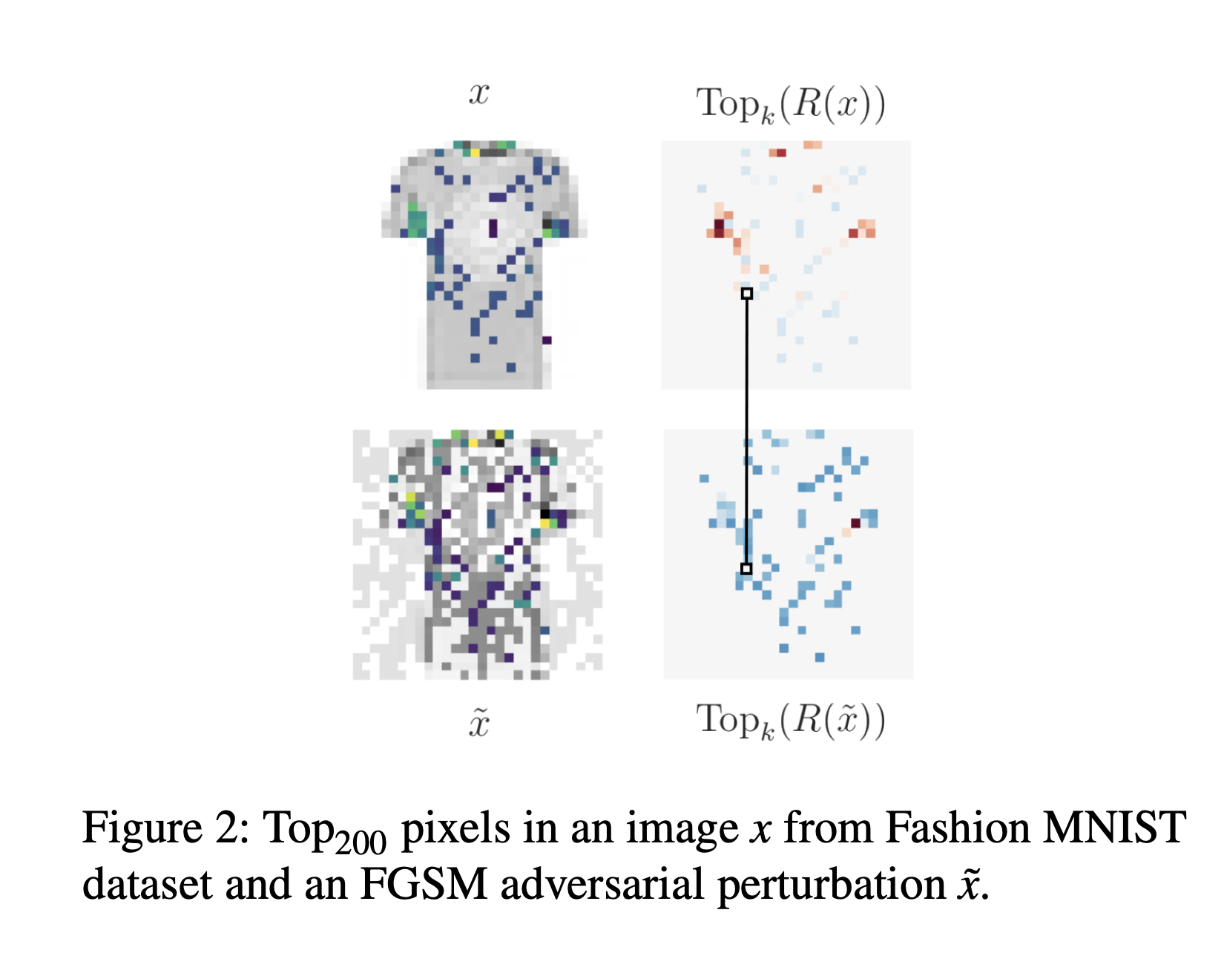
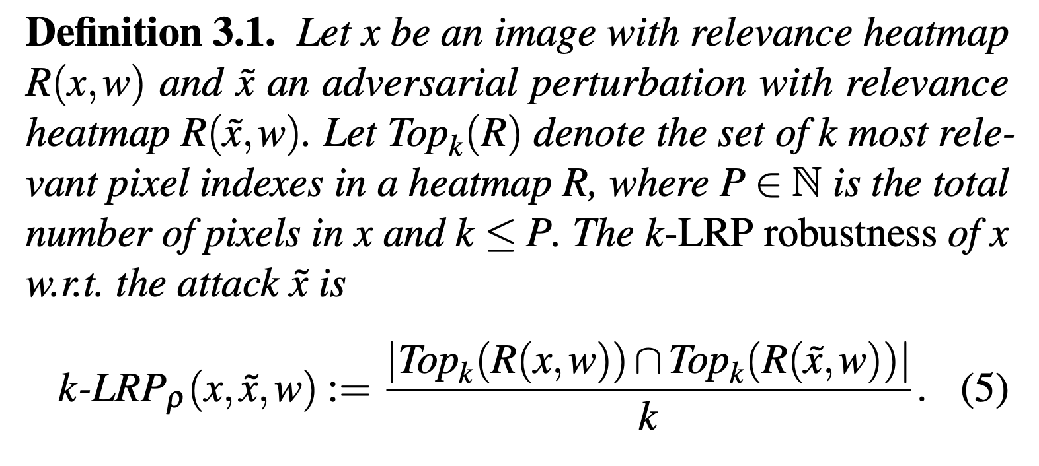
Background: LRP
Layer-Wise Relevance Propagation is a method by which we can analyze each the relevance of each pixel to an image’s classification
This Paper introduces the notion of “LRP robustness”, and realizes that this robustness is very low under adversarial attacks
Notes:
Notice that the LRP robustness of a point depends only implicitly on the strength of the attack through the attacked point x ̃.

Slide 4
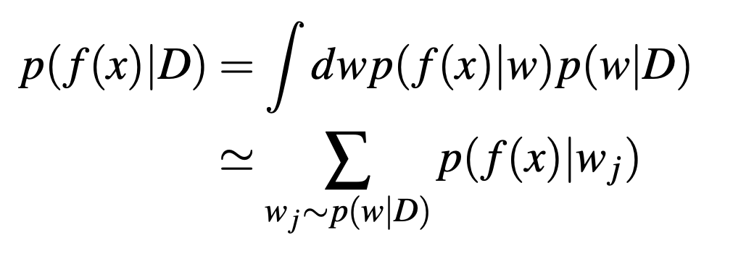
Background: Bayesian NN’s
Captures uncertainty in models by forming an ensemble of DNN models that produce predictions through the posterior predictive distribution.
The posterior is obtained by combining the prior and likelihood terms
Likelihood term takes into account how probable the data is given the network’s weights
P(W|D) = P(D|W) P(W), where P(W) is the prior, P(D|W) is the likelihood, P(W|D) is the posterior
Weights modeled as a distribution

Slide 5
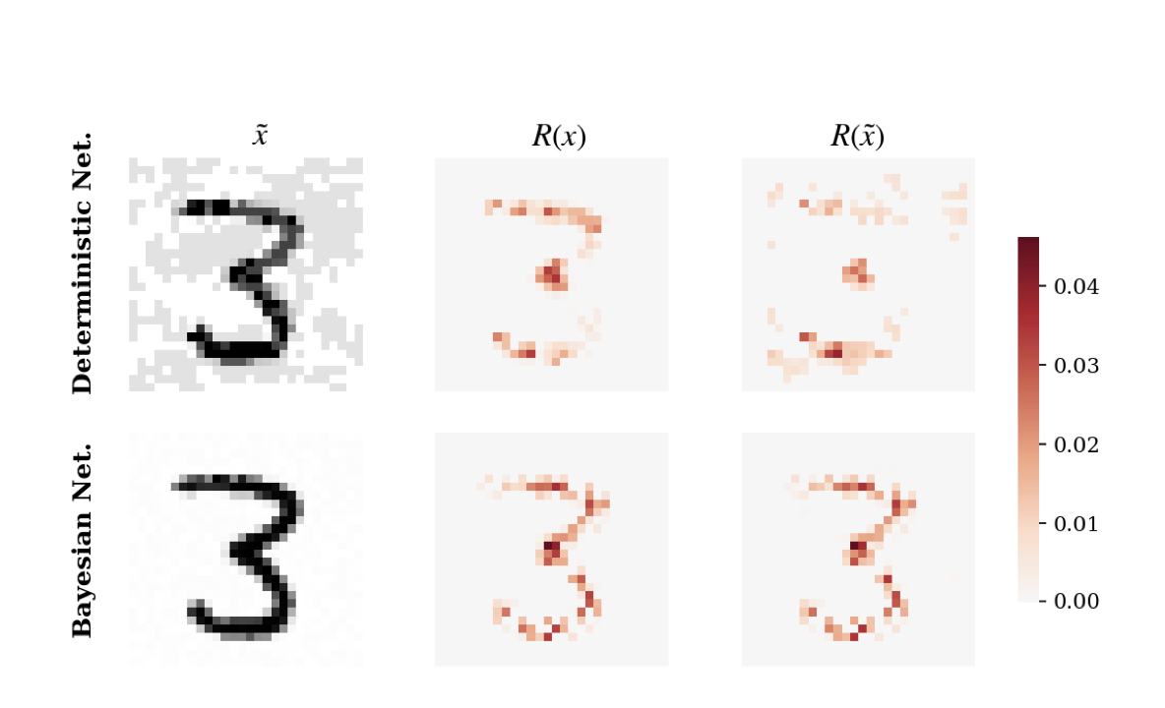
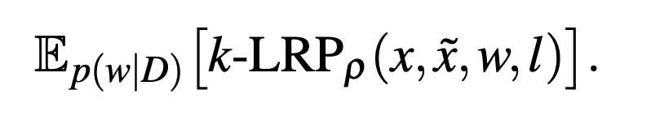
Background: Bayesian NN’s (cont.)
Recent research shows that BNN’s are adversarially robust to attacks, which raises the question of how this extends to LRP Robustness
Bayesian LRP is naturally generalized to the average of all deterministic heat maps from the ensembles
Notes:
100 most relevant pixels shown in image. The bayesian one looks a lot more stable. The adversarial attack did not even succeed to change the classification, but the difference is still drastic.

Slide 6
Methods - LRP Robustness
Uses k-LRP robustness of relevance heatmaps for adversarial attacks to assess how adversarial perturbations affect the explanations
k-LRP_{p} (x, x̃ , w) is the fraction of common k most relevant pixels for x and x̃
Analyze the behavior of LRP representations in internal layers of the network
Extends the computation of LRP heatmaps to any feature representation of input x at any learnable layer
LRP heatmaps do not refer to explanations in the classification phase but rather in the learning phases

Slide 7
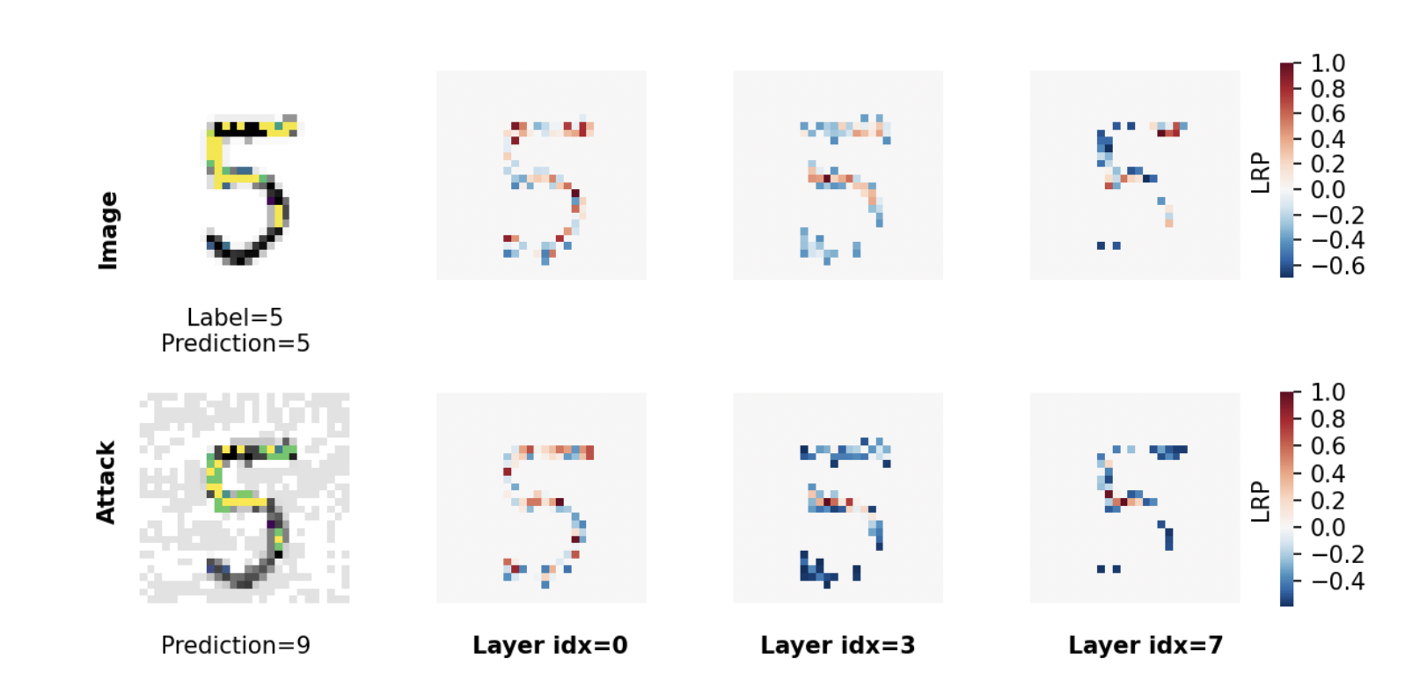
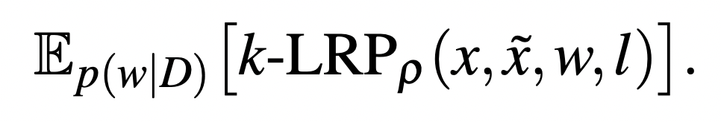
Methods - LRP Robustness + Bayes
LRP heatmaps for image x and FGSM adv. attack x̃. Each layer shows the 100 most relevant pixels.
Bayesian LRP robustness can be generalized to the bayesian setting. The average of all the deterministic heatmaps from the ensemble:

Slide 8

Methods - Geometric Meaning
To better conceptualize, discussing thermodynamic limit of infinite data and infinite expressivity of the network will help understand the Bayesian impact on LRP robustness
Main ingredients:
data manifold
a piecewise smooth submanifold of the input space where the data lie
the true input/output function g(x)
Notes:
:)

Slide 9

Methods - Geometric Meaning
Du et al. [2019], Mei et al. [2018], Rotskoff and Vanden-Eijnden [2018] proved that the DNN f(x,w) trained via SGD will converge to the true underlying function g(x) over the whole data manifold
Because the data manifold is assumed piecewise smooth, it is possible to define a tangent space to the data manifold almost everywhere
It also defines two operators
define the gradient along the normal and tangent directions to the data manifold MD at a point x of a function defined over the whole input space

Slide 10
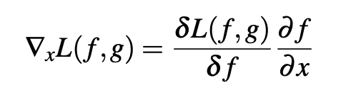
Methods - Geometric Meaning
Adversarial attacks evaluates the gradient of the loss function
In regards to the thermodynamic limit, the DNN function f(x,w) coincides with the true function everywhere on the data manifold, and the tangent gradient of the loss function is identically zero
The normal gradient of the loss is unconstrained by the data, and in a high dimensional setting, might achieve very high values along certain directions, creating weaknesses that may be exploited by an adversarial attacker
BNNs are robust against adversarial attacks

Slide 11

Methods - Geometric Means
The normal gradient of the loss function is proportional to the normal gradient of the prediction function
So, the zero-averaging property under the posterior will be inherited by the gradient of the prediction function making
BNNs in the thermodynamic limit will only retain relevant directions along the data manifold, which correspond to genuine directions of high relevance

Slide 12
Experimental Results
Compared LRP Robustness using MNIST and Fashion MNIST datasets
Adversarial attacks include Fast Gradient Sign Method (FGSM) and Projected Gradient Method (PGD)

Slide 13
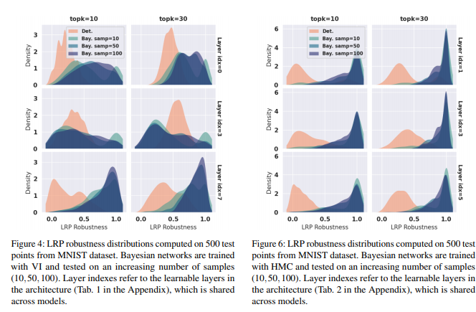
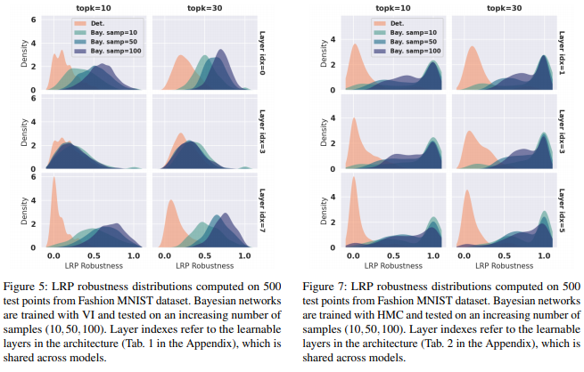
Bayesian explanations are more robust under adversarial attacks than deterministic architectures.
LRP robustness scores for both the VI and HMC training were significantly higher than their deterministic counterparts.
Notes:
First two are MNIST
And last two are fashion MNIST
Third rows are standard LRP
Top rows are initial feature representation
Middle rows are LRP of middle layers
Bayesian representation were tested using an increasing number of posterior samples
The LRP robustness of the Bayesian models with both inference methods have robustness values very close to one
Deterministic DNNs have very low LRP robustness
Hamiltonian Monte Carlo algorithm (also known as hybrid Monte Carlo), is a Markov chain Monte Carlo method for obtaining a sequence of random samples which converge to being distributed according to a target probability distribution for which direct sampling is difficult. This sequence can be used to estimate integrals with respect to the target distribution (expected values).
Another observation is that HMC are more stable across all layers while VI has a broadening LRP distribution in the intermediate layers

Slide 14
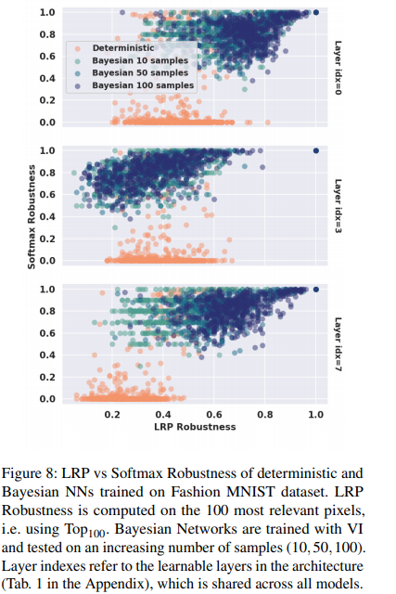
LRP robustness is correlated with Softmax robustness with Bayesian NNs.
The attacks that are more successful (lower softmax robustness) alter the interpretation of the classification more substantially.
Therefore, BNNs are likely to represent genuine directions of change of the true underlying decision function along the data manifold.

Slide 15
Conclusion
Bayesian networks, in the limit of infinite data, remedy the weaknesses of Deterministic NNs where the gradients of the loss function and the prediction functions are orthogonal to the data manifold, by averaging out irrelevant gradient directions.
BNN models also have higher LRP robustness values than DNN networks.
With BNN models, the LRP robustness correlates with softmax robustness, meaning that they capture relevant parameterizations of the data manifold.

